Slide 1
Complications in Costing
Prepared by
CMA Suresh Pimple
B.Sc. (Hons), FCMA,
Diploma in IS System Audit & Control.
Behind Every Successful Business Decision, There is always a CMA

Slide 2
Index
Applicability of cost Audit and Companies (cost records and audit) Rules, 2014.
In Costing more than 2 utility schedule are give services to each other.
Applicability of cost Audit and important interpretation of the Companies (cost records and audit) Rules, 2014.
Methodology of Valuation of work in progress.
Abnormal loss of material.
Check point in costing.
Calculation of turbine cost.
1
2
3
4
5
6
7

Slide 3
Cost Audit comprises following
Verification of the cost accounting records such as the accuracy of the cost accounts, cost reports, cost statements, cost data and costing techniques.
Examination of these records to ensure that they adhere to the cost accounting and auditing standards, principles, plans, procedures and objective. Financial Accounting Standards wherever applicable should be followed.

Slide 4
1. Applicability of cost Audit and Companies (cost records and audit) Rules, 2014.
As per Rule 4 of The Companies (Cost Records and Audit Rules, 2014) as amended up to 2019 applicability of cost audit is as below:-
“Every company specified in item (B) (i.e. non-regulated sector) of Rule 3 shall get its cost records audited in accordance with these rules if the overall annual turnover of the company from all its products and services during the immediately preceding financial year is Rupees One hundred crore or more and the aggregate turnover of the individual product or products or service or services for which cost records are required to be maintained under rule 3 is rupees thirty five crore or more.” For specified industry. Exception are Export oriented unit.
Practical difficulties in interpretation of this above definition:
Director of Cost audit branch (CAB) sent a Show cause notice to our client that appointment of cost auditor and cost audit should be mandatory on the basis of turnover mentioned in AOC-4. but turnover shows in AOC-4 include other income also but in Cost Audit turnover include the overall annual turnover of the company from all its products and services during the immediately preceding financial year(i.e. Revenue from Operation) not other income.

Slide 5
Other Income: is the income that cannot be classified as revenue from operations.
Examples:
· Profit on sale of fixed assets and investments.
· Interest from investments or deposits outside the business.
· Insurance claims received, not adjusted against an item of cost.
· Penalties or liquidated damages received, not adjusted against an item of cost.
· Fees received, not adjusted against an item of cost.
· Rent or lease from properties leased (unless the primary activity itself is leasing)
· Grants received.
· Royalties received (unless it is a part of major activity of the entity).
· Credits for previous years’ adjustments.
· Dividend income on investments (other than in a financial enterprise ).
· Gain on foreign currency transaction and translation (other than considered as finance cost).
· Excess provisions written back.
· Credits on account of revaluation of capital assets.
· All items of abnormal revenue.

Slide 6
Point No. 2 : CETA code present in regulated sector
as well as non regulated sector
a. CTA CODE- 2901-2942
The above CETA code is covered under Entry no-4 Drugs & pharmaceuticals in regulated sector.
Also covered in the Entry number-18 as Inorganic chemicals, organic or inorganic compounds of precious metals, rare-earth metals of radioactive elements or isotopes, and Organic Chemicals under Non-regulated sector.
It is to be decided whether it is Drug or Chemical. The difference between two is if it is having medicinal use then it is Drug.
If the chemical do not have medicinal use then it is Chemical only and will be covered for cost audit under Unregulated Sector.
You can therefore take a certificate from your Quality Control or R&D Department and accordingly classify the same.
CETA code and CTA code are similar in almost all cases but there are differences after chapter 19. Service industry will not have CETA code. Trading income if sizable is not part of cost of Product. Some Trading products are covered like life saving instruments like stents, pacemaker, etc.

Slide 7
Point No 3 : Selection of proper material issue system.
In accounting, especially
in manufacturing or
inventory-intensive
businesses, tracking
the issuance of materials
is crucial for accurate financial reporting.
  Identify the specific requirements of your client concerning material issuance. Consider the volume of transactions, types of materials, and the level of detail needed in tracking.
Choose a system that maintains a detailed audit trail of all material issuance transactions. This is essential for internal control and compliance purposes.
Identify the abnormal losses of martials occurred during the year. Then exclude this abnormal loss of material and directly shown in reconciliation statement.
(Note: Abnormal loss of material never charged to product cost in costing)
Obsolete stocks are not considered in financial accounting but it is take in costing and therefor the difference between these two value dealt in reconciliation.

Slide 8
Point No 3A : Material variances Analysis
For material Usage Variance Standard Quantities and rate are required.
If standard costing is not implemented then actual rate may be considered as standard rate for calculating usage variance which give management an idea of control.

Slide 9
Point 04-Depreciation on capital assets
Depreciation on capital assets
Depreciation in idle asset or asset not use and not related to plant operations should not be considered in costing.
Value for zero cost assets should be restated.
Period wise cost report are independent.

Slide 10
Point No 5 : Overheads classification / Control
In cost audit overhead are classified for primary and secondary allocation for proper control as below
Production Overhead
Administrative Overhead
Selling and Distribution
Overhead
Research and Development Overhead
Classification of overhead and allocation basis should be as per cost accounting standards or the perfect rational behind the same.

Slide 11
Point no. 6A Costing steps to be followed for doing Cost Audit.
1
4
Complete Annexure D: Value addition, financial position, GST reco., related parties.
Obtain company details from website or publications.
2
Conduct plant visit for firsthand understanding.
5
Complete Annexure A: General company info, cost auditor details, policies, audit reports.)
Input previous year figures in
XBRL instance document. If earlier year figures not provided then reason for the same should be given. In annexure in appropriate places.
Overhead management:
Ensure TB matches P&L, classify OH types.
Establish cost centers for new companies.
Calculate fixed and variable OH for cost sheet.
3
6

Slide 12
Point no. 6B Costing steps to be followed for doing Cost Audit.
Material accounting:
Track stock consumption for domestic and imported materials.
10
Analyze cost sheet for unit cost and profitability trends.
7
8
Production data:
Assess capacities and actual production for each product and Verify equation for finished goods quantities.
Provide observations and suggestions:
System improvements.
Machine constraints and capacity issues.
Market performance analysis.
11
9
Draft and review cost sheet, comparing with previous years.

Slide 13
Point no. 7 Stages in Costing
Material
Labor
Overheads
FG Valuation
WIP Valuation
Material costs include the purchase price of raw materials, freight and shipping costs, storage expenses, and any other costs directly related to acquiring materials. Valuation should be at landed cost.
Direct labor costs include wages, salaries, and benefits paid to employees directly involved in the production process, such as assembly line workers or machine operators.
Overhead costs, also known as indirect costs, represent the expenses incurred to support the production process but cannot be directly attributed to specific units of output.
Work in progress (WIP) refers to the partially completed goods or services that are still in the production process. Valuing work in progress is important for financial reporting and management accounting purposes.
Valuing finished goods involves determining their cost of production, which includes direct materials, direct labor, and overhead expenses incurred.

Slide 14
Point No. 8 : Inventory Valuation
Inventory valuation is a crucial aspect of cost accounting, as it directly impacts a company's financial statements and profitability. The valuation of inventory is essential for determining the cost of goods sold (COGS) and the value of ending inventory on the balance sheet. Various methods are used in cost accounting to value inventory, and the choice of method can significantly affect reported profits. Here are some common inventory valuation methods:
1.First-In, First-Out (FIFO):
2.Weighted Average Cost:
The weighted average cost method calculates the average cost per unit based on the total cost of goods available for sale divided by the total units available for sale. This average cost is then applied to both units sold and ending inventory.
FIFO assumes that the first items added to inventory are the first ones sold. In other words, the cost of the oldest inventory is assigned to units sold first. The remaining inventory on hand is valued at the cost of the most recently acquired items.

Slide 15
Point No. 9 : Equation for quantity control of RM &FG
In cost audit we insured that proper accounting are maintained of material and finished goods. For this we have to control using equation below:
For Raw Material(RM):
Op. Stock Of RM+ Purchase-
Cl. Stock of RM= RM Consumption
For Finished Goods(F.G):
Op stock Of F.G + Production
– Cl. stock of F.G. – self Consumption
if any=Qty. of Goods Sold.

Slide 16

Point No. 10: Molasses & Bagasse's valuation in sugar industry

Slide 17
Point No. 10: Molasses & Bagasse's valuation in sugar industry
Bagasse
Bagasse is the fibrous residue remaining after sugarcane are crushed to extract their juice. It is primarily used as a biofuel in cogeneration plants to produce electricity and heat for the sugar manufacturing process.
Closing Stock+ Sales Relisation – Opening Stock= Production Cost
First Quanties equation is made then it is applied for valuation also.
Molasses
Molasses is a byproduct of the sugar refining process. It is the syrupy residue left after sugar crystals are extracted from sugarcane juice or sugar beets.
Valuation of molasses depends on several factors including its quality, market demand, and alternative uses.
Molasses has various applications such as in the production of alcohol (both potable and industrial), animal feed, and as a component in certain food products.
Valuation depend on content of sugar in Molasses.
Since it is byproduct it is priced as average rate of sales reliasation during the period.
It is considered as credit to the expenses of cost of production od main product.

Slide 18
Point No. 11 : Joint product valuation
Classification of Joint product byproduct shall be based on the sale/relisable value.
Joint Product Byproduct, Main product shall arise from the process only.
This is applicable for process industry only.
This should not be confused with defective, seconds, scraps which normally arises in engineering type of industry.

Slide 19
Point No. 12 : Reconciliation of financial profit
with Costing profit
Inconsistent treatment of overhead costs in financial and costing systems can cause discrepancies in profit figures.
Differences in inventory valuation methods, such as FIFO (First-In, First-Out) or LIFO (Last-In, First-Out), can impact cost of goods sold and profit.
Non-financial items, such as non-cash expenses or non-operating income, may be treated differently in financial and costing reports. In costing non operating expenses should be excluded from expenses.
Difference may be arise in profit due to valuation of WIP and F.G valuation.
Treatment of valuation of WIP and F.G when we start the Reconciliation statement with costing Profit / Loss as below

Slide 20
Treatment of valuation of WIP and F.G when we start the Reconciliation statement with costing Profit / Loss as below.
When start the Reconciliation statement with Costing profit:
When start the Reconciliation statement with Costing loss:
Particular | Amt in Rs
Costing profit | xxx
(-)Overvaluation of op stock in F.A | (xxx)
(+)Overvaluation of cl stock in F.A | xxx
(+) Undervaluation of op stock in F.A | xxx
(-) Undervaluation of cl stock in F.A | (xxx)
Particular | Amt in Rs
Costing profit | xxx
(-)Overvaluation of op stock in F.A | (xxx)
(+)Overvaluation of cl stock in F.A | xxx
(+) Undervaluation of op stock in F.A | xxx
(-) Undervaluation of cl stock in F.A | (xxx)

Slide 21
Point No. 13 : How to write observation & suggestions
The points having materiality should be considered.
The Observation should be based on verified data.
Preferably observations should be discussed with management and only unresolved points should be considered.
Observations should be brief and clear for understanding.
Expect query on the same from MCA and for that purpose clear supporting data/ information shall be preserved.
Observation should be consinering only on costing and Cost Management.
Improvement and suggestions shall be included in annexures also.

Slide 22
Point No. 14 : System implementation problem in costing.
  Implementing and maintaining SAP ERP systems can be expensive. Initial setup costs, licensing fees, and ongoing maintenance expenses may pose a significant financial burden.
  SAP ERP systems are complex and may require substantial time and effort to implement successfully. Customization and integration with existing systems can be challenging, and employees may need extensive training to use the system effectively.
  In SAP and other small system like Focus or Microsoft actual cost will not be available.
  Overhead recovery rates, costing data, etc is required and to be maintained outside the system
A. SAP system reconstruction :
B. Actual cost not available in System

Slide 23
Point No. 15 : Difference between International Costing &
Indian costing
Considers global market dynamics.
Focuses on domestic market conditions and regulations.
Accounts for currency fluctuations and international trade regulations.
Considers local taxation, government policies, and subsidies in India.
Includes cross-border logistics, tariffs, and customs duties.
Includes factors such as domestic logistics, labor, and material costs.
Focuses on competitive pricing strategies in the global marketplace..
Reflects cultural preferences, consumer behavior, and regional variations in production.

Slide 24
Point No. 16 : Material loss treatment
In certain industries, it's common practice to procure
additional materials to accommodate for normal losses
that occur during the production process. However, if
further losses are incurred during production beyond the
anticipated normal losses, these variances are typically
classified as abnormal losses
Abnormal losses are those that cannot be
directly attributed to the production of a specific
product and are considered deviations from expected
norms in the manufacturing process. Proper cost
accounting methods distinguish between normal and
abnormal losses to accurately assess production
efficiency and costs attributable to specific products.

Slide 25

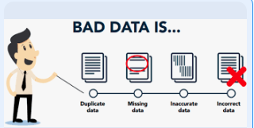

Point No. 17 : Non availability & Incorrect data from management
Non availability
of the Data:
Incorrect data from Management:
To secure proper insurance, access to relevant data
is crucial. If unavailable, estimates can suffice,
but management commitment to implementing
systems for data availability ensures accurate
assessment and coverage.
When management provides incorrect data, whether
intentionally or unintentionally, it's crucial to verify it
upon receipt. Implementing internal controls for
data verification helps ensure accuracy and enables
appropriate action based on verified information.

Slide 26
Point No. 18 : Legal problem in appointment of Cost Auditor u/s148 of companies Act, 2013.
Casual vacancy:
Any casual vacancy in the office of a cost auditor, whether due to resignation, death or removal, shall be filled by the Board of Directors within thirty days of occurrence of such vacancy and the company shall inform the Central Government in Form CRA-2 within thirty days of such appointment of cost auditor.
Correction in CRA-2
Any mistake(i.e. Selection of individual instead of Firm vice- versa) occurred in CRA-2 form is not possible to rectified this form hence to rectify such kind of mistake follow the below procedure.
“Company has to send the letter on their letter head to Cost Audit Branch of MCA regarding above mistake”
Letter for your reference below

Slide 27
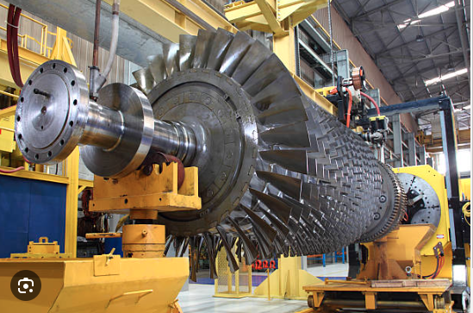
Point No. 19 : Calculation of Turbine cost
The actual process is as follows:
Steam generated in boiler
Then this steam flow transferred to turbine where only temperature gets down and this reduced temperature steam directly used to production process.
Electricity generated in turbine is also used in production process & other department.
Complication in apportionment of steam cost between Turbine and production process.
Practice follow:
As per industry norms we charged 40% to 50% steam cost to turbine and rest to production process.

Slide 28
Point No. 20 :Test performed but revene not recognize
Complication in the hospitality Costing
In certain instances, multiple tests may be performed on a single patient, with each test requiring a small component. However, the revenue generated from these individual small tests may not be recognized separately in accounting records.
As a result, the revenue attributed to these smaller tests is not isolated or distinguished in financial documentation, despite their contribution to the overall testing procedures conducted."

Slide 29
Point No. 21 : Complication in the hospitality Costing
Example
In healthcare environments, despite
nurses performing similar duties,
salary discrepancies prevail.
Consequently, the calculation
process standardizes compensation
by adopting the average nurse
salary.
In a hospital employing 10 nurses, the
remuneration structure exhibits disparity
experienced nurses earn ₹ 50,000 monthly
while newly joined counterparts receive
₹20,000. Despite their shared responsibilities,
the calculation process opts for the average
nurse salary to ascertain operational costs.
This practice aims to mitigate discrepancies and
ensure fairness in compensation across the
nursing staff.

Slide 30
Point No. 22 : Abnormal Cost of Material
In the computation of material costs for hospital services, it is customary to account for abnormal costs of materials, particularly when the exact usage cannot be determined. This accounting practice aims to ensure accurate cost allocation despite fluctuations in material consumption.
For instance, consider a scenario where a single pack of material facilitates the execution of 100 tests, yet only 1-2 tests are performed. In such instances, the residual cost associated with the unused portion of the material is allocated to the tests conducted due to the unavailability of precise usage data.
This approach to costing acknowledges the inherent variability in material consumption within healthcare settings and endeavors to reflect the true cost incurred for services rendered..

Slide 31
oPoint No. 23 : Non-availability f Issue Register
Due to the lack of an issue register, hospitals employ Goods Received
Notes (GRNs) as the basis for
calculating material consumption. This method allows for an illustrative
approach to determine usage.

Slide 32
Point No. 24 : Incorrect Basis.
In certain instances, expenses recorded in the Trial Balance (TB) lack a clear basis for accurate distribution.
Consequently, these expenses are allocated based on the tests performed.
This method ensures a reasonable and proportional distribution of expenses, albeit in the absence of specific allocation criteria, thereby maintaining financial accuracy and integrity in accounting practices."

Slide 33
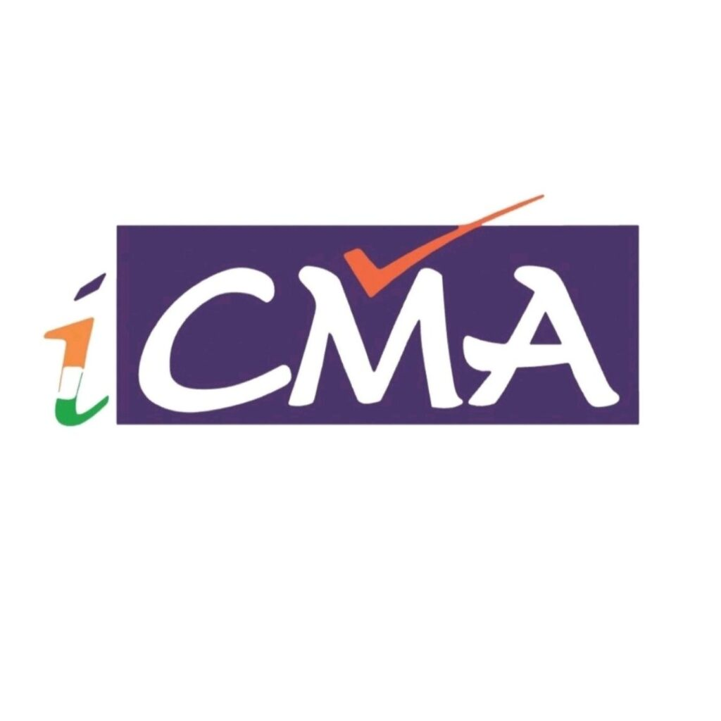
Cost & Management Accountant
Behind Every Successful Decision There is always a CMA

Slide 34


Slide 35


