Slide 1
JOINT AND BYPRODUCT COSTING
BY CMA ANANT JAGANNATH DARGAD

Slide 2
















OVERVIEW
Joint Products & By-Products
Meaning of Joint Products
and By-Products
Treatment of By-Product
Cost in Cost Accounting
Apportionment of Joint Costs

Slide 3
DEFINATIONS
Joint Products - Joint products represent “two or more products separated in the course of the same processing operation usually requiring further processing, each product being in such proportion that no single product can be designated as a major product”.
By-Products - These are defined as “products recovered from material discarded in a main process” i.e. product which is recovered incidentally from the material used in the manufacture of main or desired products, such a by-product having either a net realisable value or a usable value which is relatively insignificant in comparison with the saleable value of the main or desired products. By-product may be further processed to increase their realisable value

Slide 4
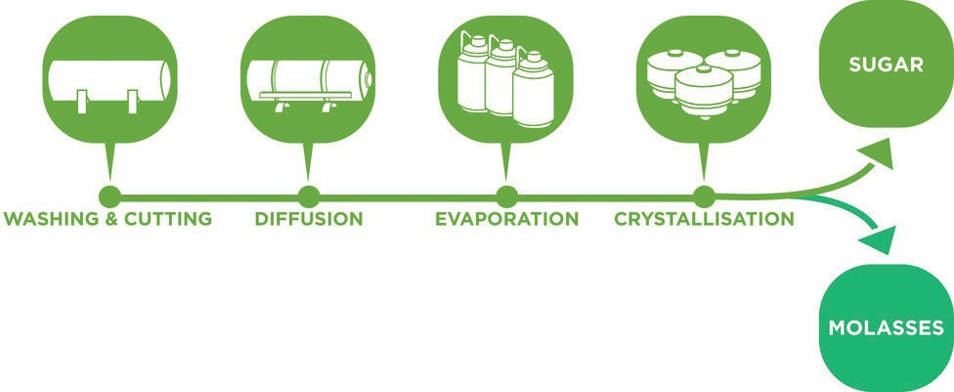
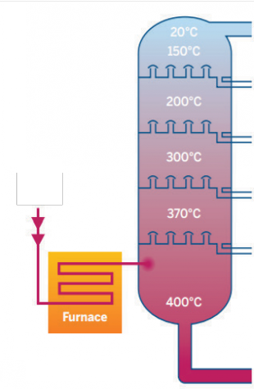
Petroleum Gas
Gasoline (Petrol)
Kerosene
Diesel
Industrial Fuel Oil
Lubricating Oil, Paraffin Wax and Asphalt
Petroleum Refining Processes
Molasses is produced as a Byproduct in the process of Sugar Manufacturing
Crude Oil

Slide 5
Co-Products
Co-Products
Co-Products
Joint products and co-products are used synonymously, but a distinction is there.
.
Co-products are two or more products which are contemporary but do not emerge necessarily from the same material in the same process.
For instance
wheat and gram produced in two separate farms with separate processing of cultivation are co-products.
Timber boards made from different trees
are co-products.

Slide 6
Split of Point
Split of Point – this is a point in a production process where joint products emerging from the process gets separately identifiable.
Split of Point has its importance in the joint product costing as joint cost incurred up to this point only and needs to be borne jointly by the products emerging from the common process.
Any cost incurred after Split of Point is a product specific cost and to be borne by the product concerned.

Slide 7
APPORTIONMENT OF JOINT COST TO JOINT PRODUCTS
Why Necessary ??
As the relations between materials, processes and joint products are complex and unobservable, there is no way to determine the cost of the different production factors used in the processes for the production of each of the joint products. Therefore, the costs incurred in the manufacture of each of the joint products cannot be correctly identified.
It can only be apportioned to the joint products by using some rational methods

Slide 8
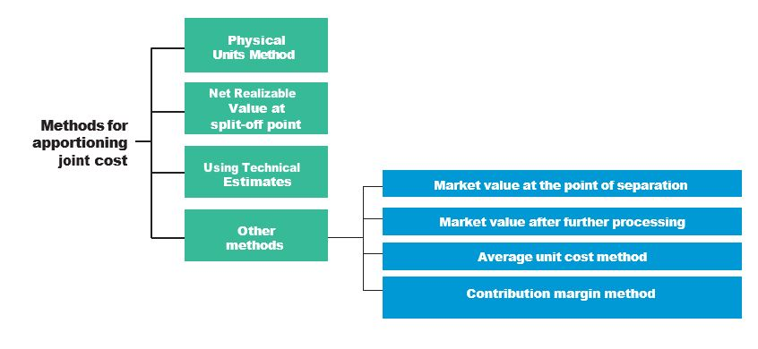
METHODS OF APPORTIONMENT OF JOINT COST TO JOINT PRODUCTS

Slide 9
Physical Unit Method
This method is based on the assumption that the joint products are capable of being measured in the same units. Accordingly, joint costs here are apportioned on the basis of some physical base, such as weight, numbers etc
In situation where physical units are different, the joint products must be converted to a common unit of measurement. In case, the same cannot be converted to a common unit of measurement, this method cannot be applied

Slide 10
Example
A coke manufacturing company produces the following products by using 5,000 tonnes of coal @ Rs 1,100 per tonne into a common process.
Coke | 3,500 | tonnes
Tar | 1,200 | tonnes
Sulphate of ammonia | 52 | tonnes
Benzol | 48 | tonnes

Slide 11
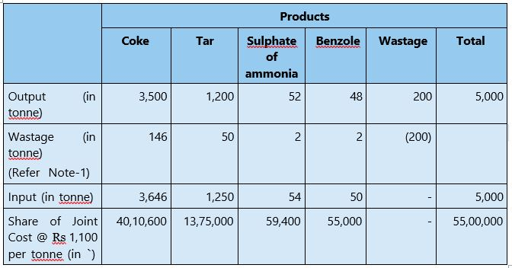

Slide 12
Net Realizable Value at Split-off Point Method
To arrive at the sales value at the split-off point, following are deducted from the sales value of joint products at final stage i.e. after processing:
Directly attributable Selling and distribution expenses like freight, royalty, commission, etc.
Post split- off processing cost.

Slide 13
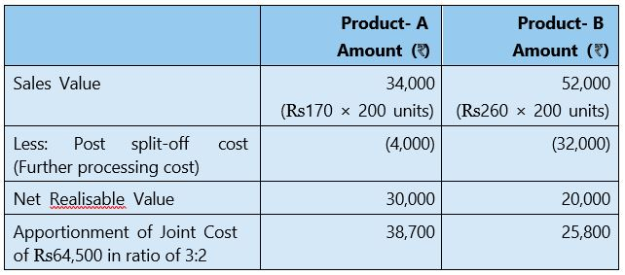
Example
An entity incurs a joint cost of Rs 64,500 in producing two products A (200 units) and B (200 units) and earns a sales revenue of Rs 86,000 by selling @ Rs 170 per unit of product A and product B @ Rs 260 per unit. Further processing costs for products A and B are Rs 4,000 and Rs 32,000 respectively the Joint cost can be apportioned to products A and B as follows:

Slide 14
Using Technical Estimates
This method uses technical estimates to apportion the joint costs over the joint products. This method is used when the result obtained by the above methods does not match with the resources consumed by joint products or the realisable value of the joint products are not readily available.

Slide 15
Market value at the point of separation
It is a useful method when the realisable value of joint products at split-off (point of separation) is known and where further processing costs are incurred disproportionately.
To determine the apportionment of joint costs over joint products, a factor known as multiplying factor is determined
Multipy in factor : Joint Cost X 100
Total Sales Revenue

Slide 16
Example
An entity incurs a joint cost of Rs 64,500 in producing two products A (200 units) and B (200 units) and earns a sales revenue of Rs 86,000 by selling @ Rs 170 per unit of product A and product B @ Rs 260 per unit.
The multiplying factor in this case is obtained by dividing the total joint cost by total sales revenue and finally multiplying the figure so obtained by 100. The multiplying factor based on the data can be computed as follows:
Multiplying Factor: Rs 64,500 × 100 = 75%
Rs.86,000
Joint cost apportioned over product A = Sales revenue of product A × 75%
= Rs 34,000 × 75% = Rs 25,500
Joint cost apportioned over product B = Sales revenue of product B × 75%
= Rs 52,000 × 75% = Rs 39,000

Slide 17
Market value after further processing
The basis of apportionment of joint cost is the total sales value of finished products and involves the same principle as discussed above.
The use of this method is unfair where further processing costs after the point of separation are disproportionate or when all the joint products are not subjected to further processing.

Slide 18
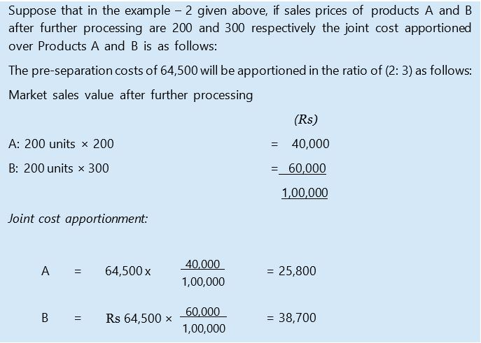
Example

Slide 19
Average Unit Cost Method
Under this method, total process cost (upto the point of separation) is divided by total units of joint products produced. On division average cost per unit of production is obtained.
Average unit cost = Total process cost (upto the point of separation) ÷ Total units of joint product produced.

Slide 20
Example
FIND OUT the cost of joint products A, B and C using average unit cost method from the following data:
Pre-separation Joint Cost Rs 60,000
Production data:
Products | Units
A | 500
B | 200
C | 300

Slide 21
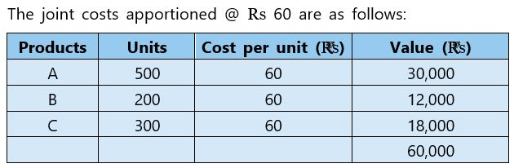
Average cost per unit = Total joint costs = Rs 60,000 = Rs 60 Units produced 1,000 units

Slide 22
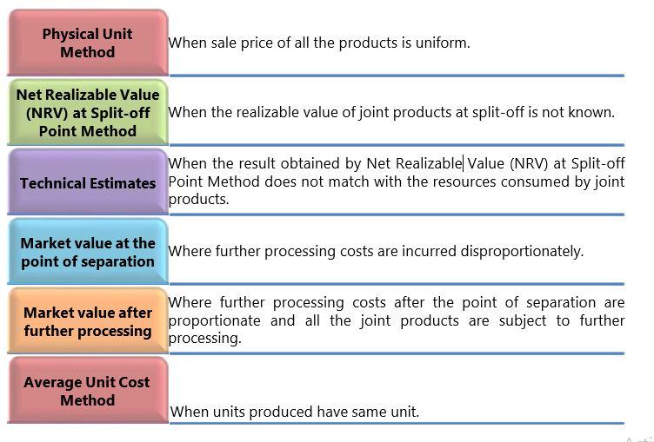
Summary

Slide 23
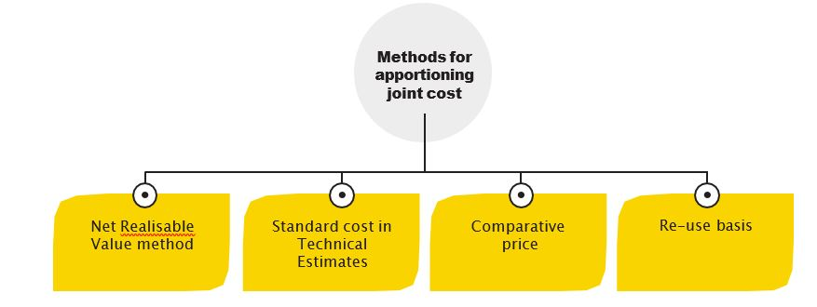
Methods of apportionment of Joint Cost to Byproduct

Slide 24
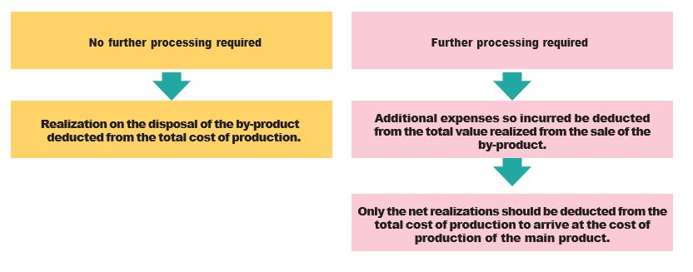
Net Realisable value Method

Slide 25
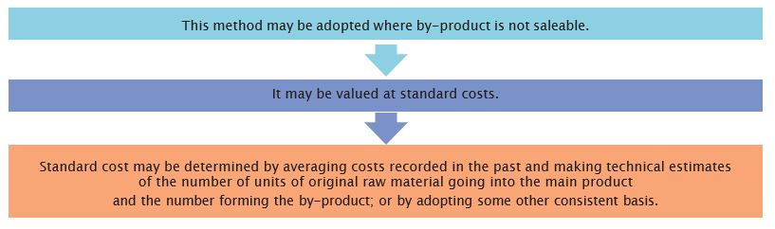
Standard cost in Technical Estimates

Slide 26

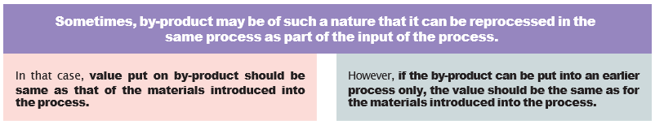
Comparative price
Reuse basis

Slide 27
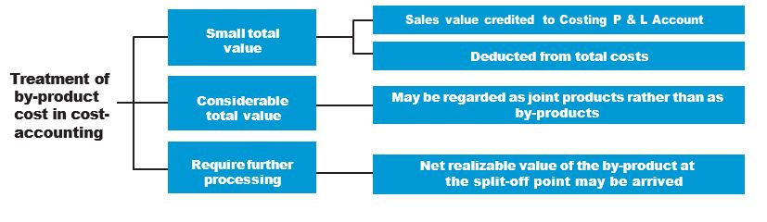
Treatment Of By-Product Cost In Cost-Accounting

Slide 28
CAS-19 COST ACCOUNTING STANDARD ON JOINT COSTS
The Cost statement shall disclose the basis of allocation of Joint costs to individual
products and the value assigned to the By-Products
The Cost statement shall also disclose:
The disclosure should be made only where material, significant & quantifiable.
Disclosures shall be made in the body of Cost Statements or as a foot note or as a
separate schedule.
Any change in the cost accounting principles and methods applied for the
measurement and assignment of the Joint costs and the value assigned to by-product
during the period covered by the cost statement which has a material effect on the Joint/
By-Products shall be disclosed. Where the effect of such change is not ascertainable
wholly or partly the fact shall be indicated.

Slide 29


