Slide 1
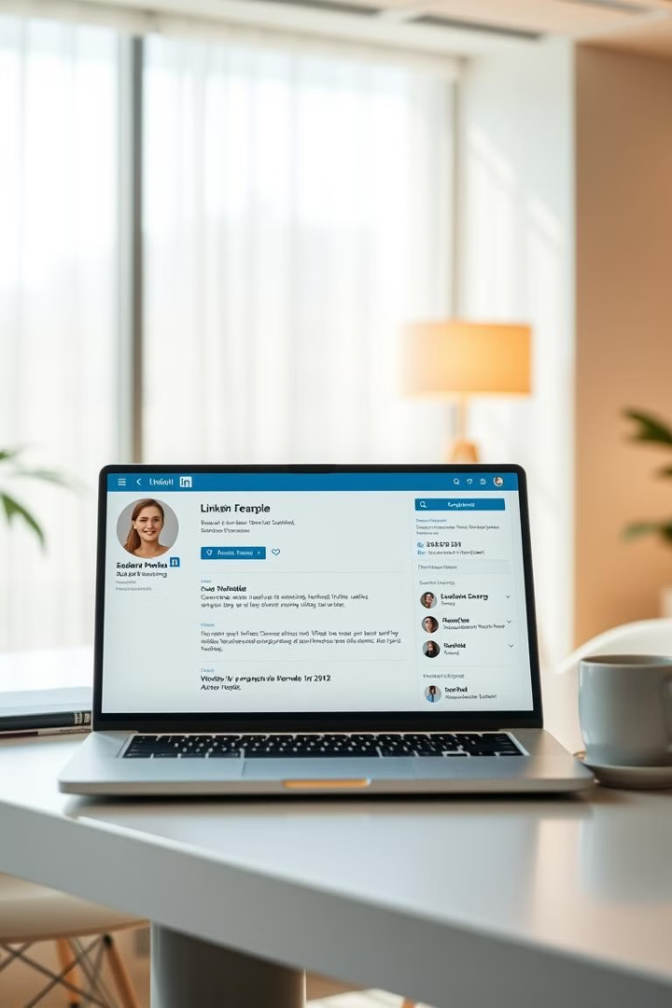
Unlock Your LinkedIn Potential: Mastering Profile Optimization
Welcome! In today's competitive landscape, a strong LinkedIn profile is essential for career advancement. We'll explore key elements to optimize your profile for visibility and success.

Slide 2
Importance of a Strong LinkedIn Profile
Professional Brand
Networking Powerhouse
Your LinkedIn profile serves as your online resume and professional brand. It showcases your skills, experience, and achievements, attracting potential employers, collaborators, and clients.
LinkedIn is a powerful platform for networking. It allows you to connect with professionals in your industry, build relationships, and stay updated on industry trends.

Slide 3
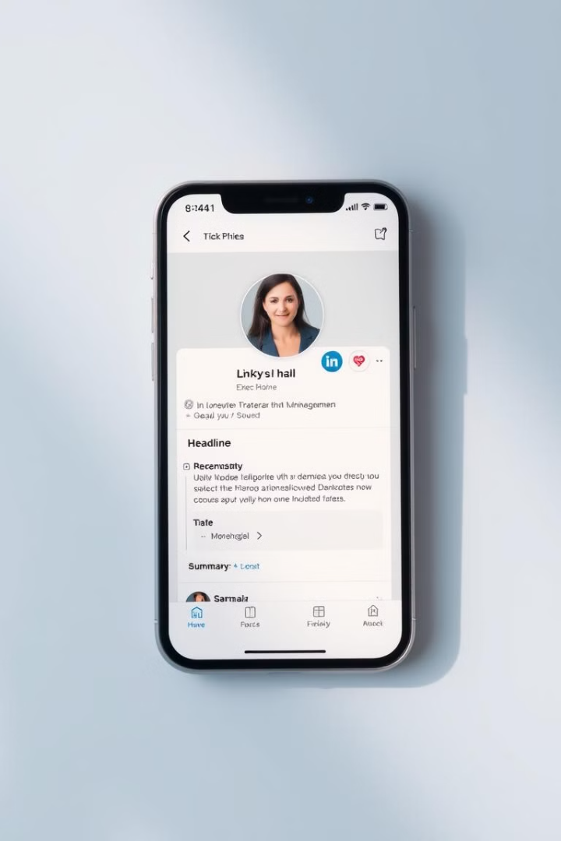
Key Elements of an Effective Profile
Professional Photo
Headline and Summary
A high-quality professional photo is essential to make a strong first impression. Choose a clear, well-lit image that reflects your professionalism.
Your headline should be a concise and compelling statement that summarizes your professional identity and expertise. Your summary should elaborate on your professional journey, goals, and value proposition.
Experience and Skills
Your experience section should highlight your relevant professional roles, accomplishments, and key skills. Use keywords to increase your visibility in search results.

Slide 4
Crafting a Compelling Headline and Summary
Keyword-Rich Headline
Value-Driven Summary
Include keywords that describe your target roles and skills. For instance, "Marketing Manager | Digital Marketing Expert | SEO Specialist."
Focus on your key achievements, skills, and career goals. Showcase your value proposition to potential employers, collaborators, and clients.

Slide 5
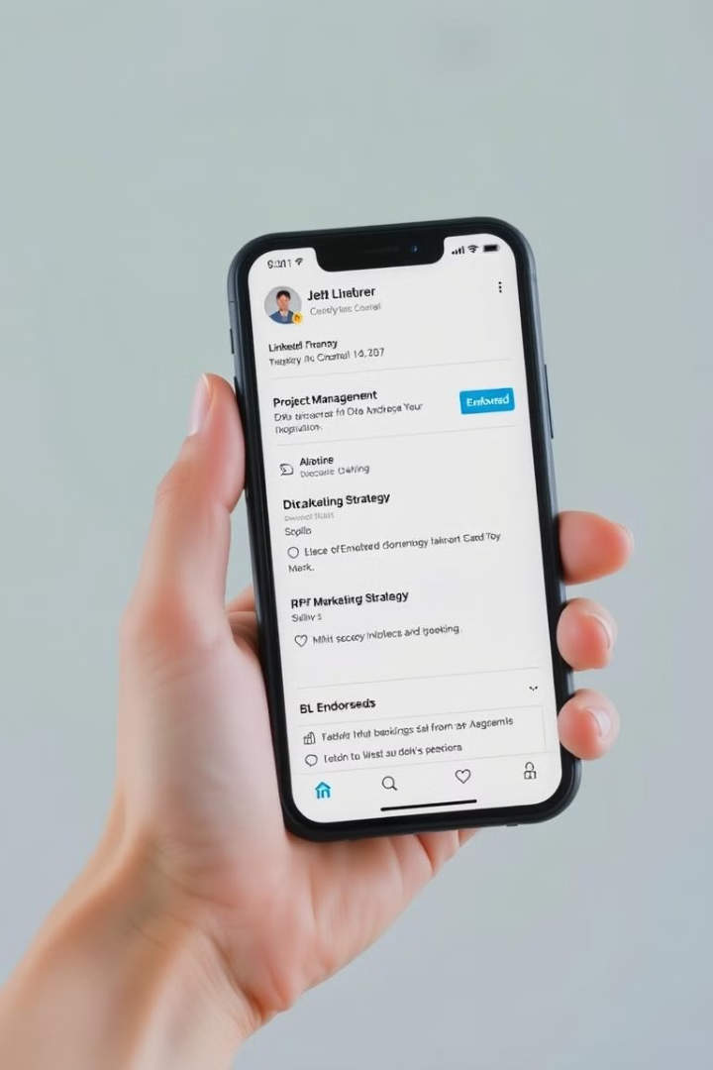


Highlighting Your Relevant Skills and Expertise
Skill Endorsements
Experience Details
Request endorsements from connections who can attest to your skills. This builds credibility and boosts your profile's visibility.
Describe your roles and responsibilities in detail. Use action verbs and quantify your achievements whenever possible.

Slide 6

Leveraging Multimedia Content
Images and Videos
Articles and Posts
Add visual elements to your profile to enhance engagement. Share relevant images, videos, and presentations to make your profile more dynamic and engaging.
Contribute valuable content to the LinkedIn platform. Share articles, insights, and thought leadership pieces to position yourself as an expert in your field.

Slide 7
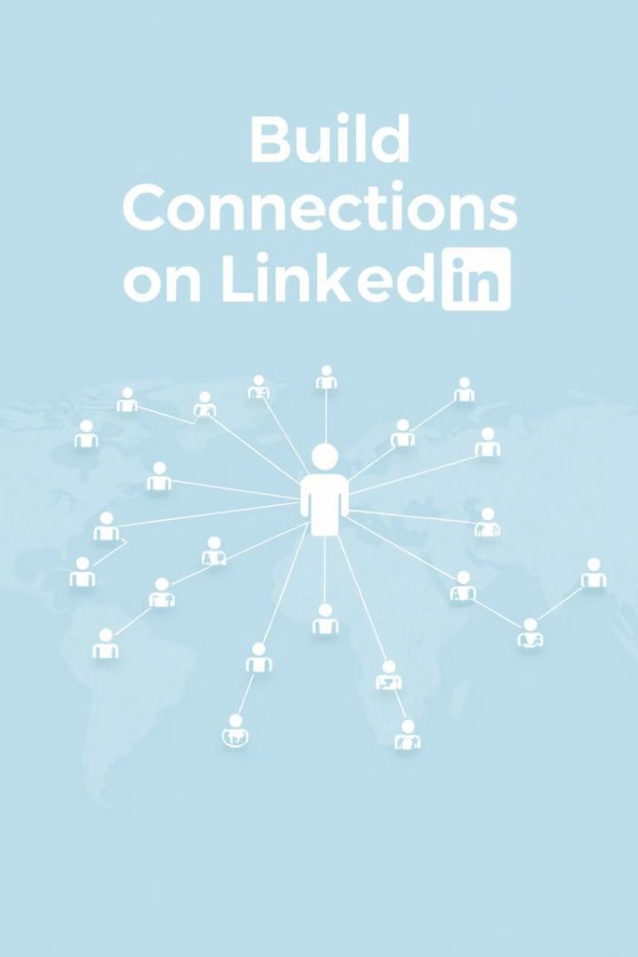

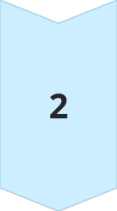
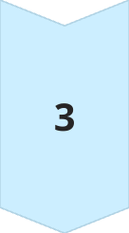
Building a Robust Professional Network
Connect with Professionals
Reach out to individuals in your industry, former colleagues, and mentors to expand your network and build relationships.
Join Groups
Engage in relevant LinkedIn groups to connect with like-minded professionals, participate in discussions, and share valuable insights.
Follow Companies
Follow companies you admire or are interested in working for. This allows you to stay updated on their latest news and opportunities.

Slide 8



Optimizing for Search Engine Visibility
Keywords
1
Research relevant keywords and incorporate them into your headline, summary, experience, and skills sections.
Profile Completeness
2
Fill out all sections of your profile to maximize its visibility in search results. The more complete your profile is, the better your chances of being found.
Engagement
3
Engage with content, join conversations, and share updates to increase your profile's visibility and attract potential connections.

Slide 9
Maintaining an Active and Engaged Presence
Regular Updates
1
Share valuable content, updates, and insights to keep your profile active and engage your network.
Content Sharing
2
Share relevant articles, blog posts, and industry news to establish thought leadership and build credibility.
Network Engagement
3
Engage with your network by liking, commenting, and sharing content. This helps you build relationships and stay top-of-mind.

Slide 10
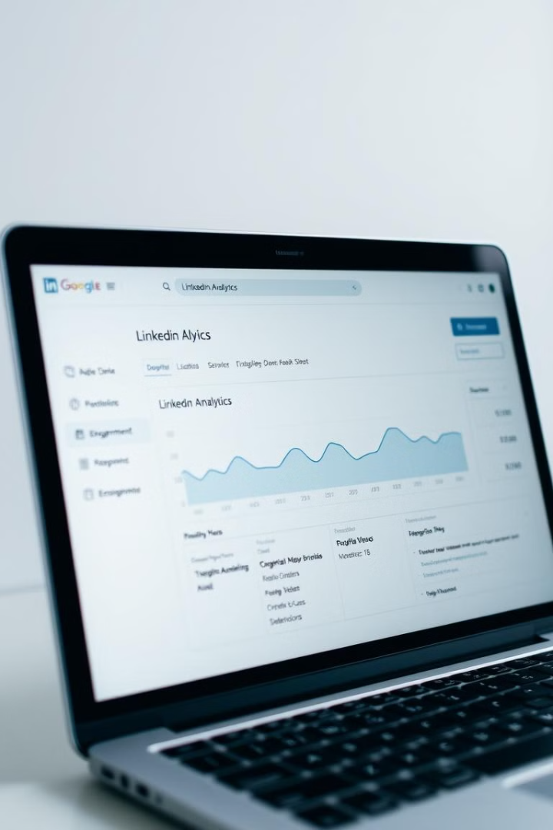
Utilizing LinkedIn Analytics for Continuous Improvement
1
Track Performance
Utilize LinkedIn Analytics to monitor your profile's performance. Identify what content resonates with your audience, and adjust your strategy accordingly.
2
Optimize Regularly
Continuously improve your profile based on the insights gained from analytics. Update your content, keywords, and skills to remain relevant and competitive.
3
Experiment and Iterate
Try different approaches to content creation, networking, and engagement to discover what works best for you and your audience.

